Slide 1
Development and Optimization of a Soft-Projectile Launcher Utilizing Mechanical Energy
Aaron Wagner
Mike Knoop
University of Missouri, MAE Capstone 4980, Fall 2011
Notes:
Unique capstone project
Chose our own from common interests
Identified an existing, unsolved problem

Slide 2
HvZ Image
Notes:
Introduce humans vs zombies

Slide 3
Defining the Problem
Notes:
This is truly an unsolved issue

Slide 4
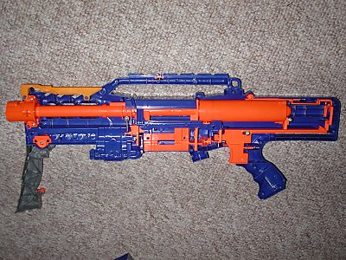
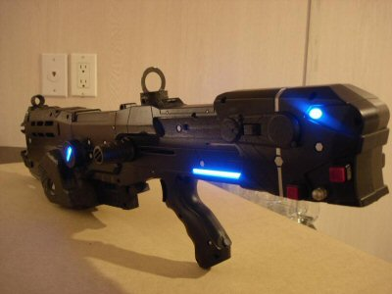
Consumers modify blasters to increase power

Slide 5
Increasing power decreases performance
Notes:
Performance is accuracy and distance
- Accuracy, darts veer drastically (and unpredictably) off target
- Distance, where the dart takes a more-than-ballistic approach to ground
Too much power behind darts cause un-aerodynamic flight
Other people have tried to solve using rifling (like traditional firearm) in the barrel but doesn’t work because of friction and nature of foam darts
Others had modified the darts in potentially unsafe manners. We operate under the constraint that the dart cannot be modified.

Slide 6
Goal of this capstone group
Verify if adding rotation to darts improves flight characteristics
Develop and optimize a design to maximize performance
Notes:
Big picture goal is generically improve an existing soft projectile launcher design
Existing SPLs have very poor dart flight characteristics
***We believe adding rotation to darts will improve flight chars

Slide 7
Defining Performance
Distance
Shot Grouping
Consistency of (a) and (b)
Notes:
Increasing consistency (c) is our primary goal. Existing power-increased SPLs are extremely inconsistent.
Under the condition of increased power.

Slide 8
Quality Function Deployment
 | Cost of Manufacture | RPM of Soft Projectile | Distance Traveled | Shot Grouping | Weight of soft projectile | Non Custom Parts | Mass of System | Muzzle Velocity | Current Competitors | Customer Importance | Improvement Ratio
Increased Effective Range |  | 9 | 9 | 9 |  |  |  | 9 | 3 | 5 | 1.7
Safety |  |  |  |  | 9 |  |  | 6 | 4 | 4 | 1
Cost | 9 |  |  |  |  | 9 |  |  | 4 | 4 | 1
Weight |  |  |  |  | 1 |  | 9 |  | 3 | 3 | 1
Durability of System | 1 |  |  |  |  | 3 |  |  | 3 | 3 | 1
Absolute Importance | 39 | 45 | 45 | 45 | 39 | 45 | 27 | 69 | 354
Relative Importance | 11 | 13 | 13 | 13 | 11 | 13 | 8 | 19
Current Competitors | 5 | 1 | 2 | 2 | 5 | 5 | 4 | 2
Technical Difficulty | 5 | 3 | 3 | 4 | 5 | 5 | 5 | 4
Target Value | a |  | 7.7* | b |  |  |  | 40
Units | $ | RPM | m | cm |  |  |  | m/s
 | Notes
 | a | Less than $200
 | b | 22.6±12.3
 | * | This value is expected to change once adjustments are made to account for improvements resulting from the copper breach.
Notes:
The QFD allowed us to define exactly what increase in performance is desired to consider our goals achieved. According to our QFD, we desire a 70% in performance (distance, accuracy, consistency).

Slide 9
Design Strategy: Iteration
Notes:
Iteration is extremely important to design, few, if any, designs are perfect on first design
We took this heart in our design process, realizing we needed to verify many of our hypotheses as we built.
Hypos:
it is not currently known whether rotation will significantly improve flight performance of soft foam darts
Existing SPLs do not add rotation to darts

Slide 10
Designing the Initial Prototype
Notes:
We generated 2 concepts for adding rotation:
Mechanical flywheels
Air power
Since many existing SPLs utilize air power, it makes sense to keep one energy source.
However, flywheels greatly simplify assembly and analysis.
So, what are these mechnical flywheels you speak of?

Slide 11
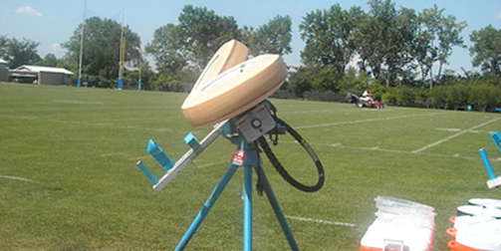
Design inspiration
Notes:
Existing flywheel device is a football throwing machine.

Slide 12
Design Strategy: Mock Launcher
Notes:
We attempted to build a mock launcher to reduce outside factors and allows us to be more confident in our statement whether rotation actually improves flight chars. This is the basis for our initial prototype concept.

Slide 13
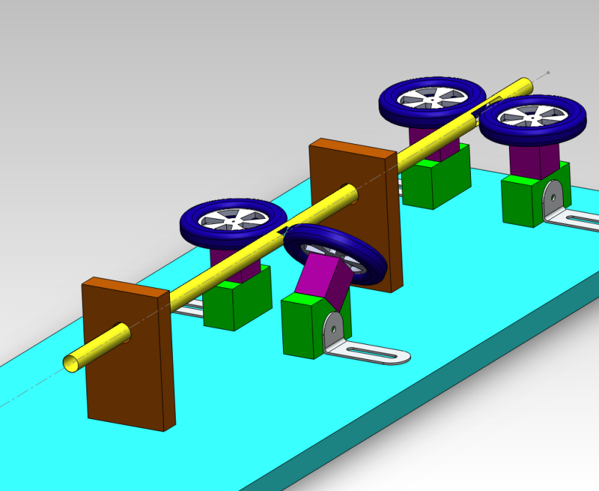
Initial Prototype Concept
Direction
of Motion
Notes:
Explain the initial concept
We use the back set of flywheels to mock the existing SPLs air power (goal: more closely simulate real SPL)
We use the front set of flywheels to impart the torque
We use the piece of barrel in front of torqueing flywheels to correct flight
We have the flywheels inset an arbitrary distance into the barrel
- This can be adjusted by sliding the brackets out
- Next we need to choose the rotational velocity of wheels

Slide 14
Selecting a Flywheel Rotational Velocity
Notes:
Motors are readily available online, typically measured in RPMs

Slide 15
Measuring muzzle velocity of existing soft-projectile launcher
Notes:
Didn’t have a highspeed camera (yet!)
Had to get creative
Used a cell phone camera to record this nerf longshot firing at a target at a known distance
Open the audio of the recording in editor (shown)
Measure the distance between peaks, divide by the known firing distance to get a velocity.
This is technically an avg velocity. Reduce the known distance until the peaks cannot be distinguished (allows you to get as close an approx. to muzzle velocity as possible).

Slide 16
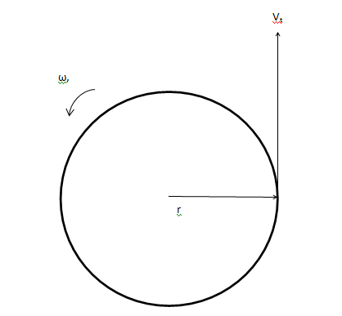
Calculating a necessary rotational velocity
$$V_{t}= ω∙r$$
$V_{t}$ = 30 m/s
$r$ = 3.81 cm.
$ω$= 7500 RPM
Notes:
Radius is 1.5 inches, this is the maximum size wheel which was readily available.
We found a motor with a loaded rotation velocity of 8000 RPM

Slide 17
Construction and Development
Notes:
So now we’re going to go through our actual iteration and construction process.

Slide 18
"A successful FMEA activity helps a team to identify potential failure modes based on past experience "
Failure Mode Effects Analysis
Notes:
Explain that FMEA allows groups to iterate intelligently based on past failures
Mention we did a full analysis, in the paper

Slide 19
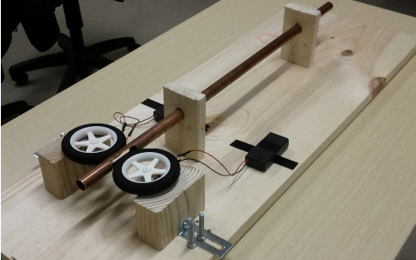
Initial Prototype Build
Direction
of Motion
Notes:
To start, we only added the back set of flywheels. Getting these working is a prereq for adding the front set.
Problems would be hard to isolate if we integrated both sets at once.
We immediately had jamming problems where the dart would become lodged a few inches past the back flywheels inside the barrel. We originally did not have access to a high speed camera so we hypothesized that gravity might be pulling the dart downwards (causing jamming).

Slide 20
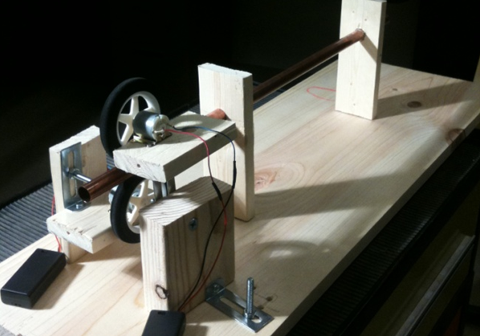
Second Prototype Build
Direction
of Motion
Notes:
We re-oriented the wheels to be vertical so that gravity pulled the darts into the flywheel instead of the side wall. Unfortunately, this did not improve jamming. Jamming still occurred.
Later highspeed analysis confirms this.

Slide 21
Highspeed of Jamming
http://www.youtube.com/watch?v=c_Mi0BmmiFc&list=PL0FF1657C0B08FAB8
Notes:
All highspeed taken at 2000 fps

Slide 22
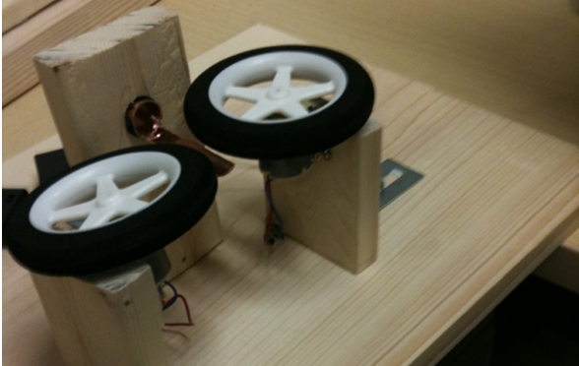
Third Prototype Build
Direction
of Motion
Notes:
We eventually decided that getting the back set of flywheels to work properly was insignificant because we were only mocking an existing SPL. We didn’t actually need it.
Moreover, we wanted to eliminate the problem of “dart back into barrel” jamming we had with the first and second prototypes.
We settled on a very simple, open configuration which very closely resembles the origin design inspiration (football throwing machine)
Note the angled wheel, this configuration adds both forward and rotational velocity to the dart
It wasn’t perfect, and introduced a new problem we called “fishtailing”.
At this point in the iteration process we got access to a highspeed camera.

Slide 23
Highspeed of Fishtailing
http://www.youtube.com/watch?v=BSyDEoXlY4c&list=PL0FF1657C0B08FAB8

Slide 24
Highspeed of Single-Prong Barrel Close-up
http://www.youtube.com/watch?v=87Y0A6IMJM8&list=PL0FF1657C0B08FAB8

Slide 25
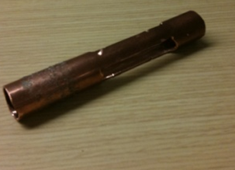
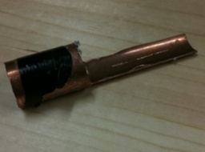
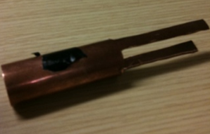
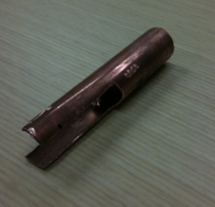
Barrel Iteration
Notes:
The highspeed analysis seemed to indicate that centerline is important.
If the dart doesn’t make centered contact with the flywheels, it get’s thrown off center. Possible leads to fishtailing.
We tried a few different barrel iterations
Initial (showed lots of fishtailing, lead to investigation of alt. barrels)
Thin tabs with fully enclosed ring
Thin tabs on top and bottom (helped a little bit, highspeed revealed why, springy)
Thick tabs top and bottom

Slide 26
Highspeed of Double-Prong Barrel Close-up
http://www.youtube.com/watch?v=f1uctE_u4qk&list=PL0FF1657C0B08FAB8

Slide 27
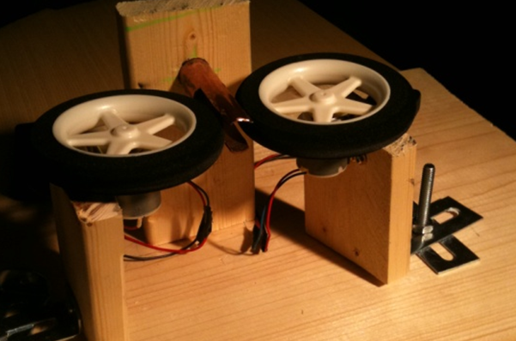
Final Prototype Build
Direction
of Motion
Notes:
Double-barrel, thick design
Allows wheels to be rotated 20 degrees to find best angle
Allows wheels to be at varying distances apart
Used extra sliding hardware to line up centerline just right

Slide 28
Testing and Optimization

Slide 29
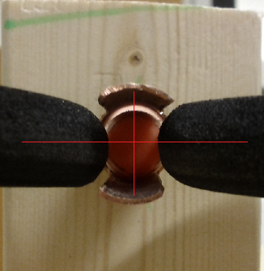
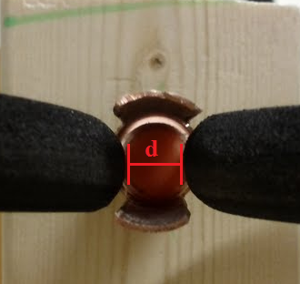
Parameters to Optimize
Flywheel rotation angle
Flywheel gap distance
Notes:
Our “optimization” goal started out as “maximize rotational velocity” (both angle and gap affect this)
However it became quickly apparent that fishtailing is still observed in moderate amounts at large flywheel angles and nonexistant when the flywheels have no angle.
Highspeed footage revealed something very interesting…

Slide 30
Foam darts with high rotational velocities are less-able to self-correct!
1250 RPM
High tip-off
Actually self-corrects
5000 RPM
Little apparent tip-off
Actually fishtails
Notes:
This is suggested by our highspeed footage and test results. The highspeed footage at high flywheel angles (and thus higher rotational velocities) shows darts with little apparent tip-off actually fishtail.
And it also shows darts with low rotational velocities with high degrees of tip-off are able to self-correct.
Thus, maximizing rotational velocity is not desired.
This is something we never could have known in our initial design and why iterative design is important.

Slide 31
1250 RPM Barrel Close-up
http://www.youtube.com/watch?v=9cDyEDYOw7E&list=PL0FF1657C0B08FAB8

Slide 32
5000 RPM Barrel Close-up
http://www.youtube.com/watch?v=wBa-ZM7owLc&list=PL0FF1657C0B08FAB8

Slide 33
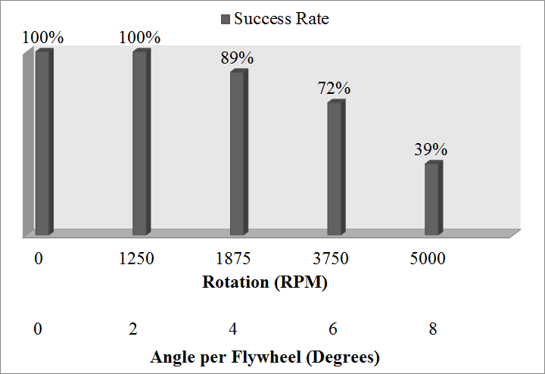
Selecting a Flywheel Rotational Velocity
Notes:
Success means the dart did not fishtail
We chose a 2 degree per flywheel angle, giving us 1800 RPM at barrel exit.

Slide 34
Selecting a Flywheel Gap Distance
Notes:
We shot a bunch of darts and came up with this nice plot
Chose a gap distance of 0.35 in.

Slide 35
Does Rotational Velocity Help?
Notes:
So we have an optimized SPL configuration which minimizes fishtailing and adds around 1900 RPM to the dart.
Does it actually improve the performance characteristics which we set out to improve?

Slide 36
Yes
Distance
+4.6 ft. (14%)
Standard Deviation
-2.3 ft. (40%)
Notes:
This is a histrogram of our test results when firing our optimized SPL at 0 degrees (no rotational velocity, neutral) and 4 degrees per wheel (1900 RPM)
The angled shots travelled about 5 feet further and their shot grouping was more consistent by 2.3 feet (nearly double!).

Slide 37
Future Work
Precision machining
Foam dart wear
Integrating into an existing SPL

Slide 38
Final Thoughts
Iteration is very important
Pick a project which motivates you
Relevance, Market Size

Slide 39
Acknowledgments
Humans vs. Zombies Mizzou for project funding
Brian Graybill for teaching us SolidWorks
Dr. El Giz-awy for Capstone guidance
Richard Oberto for fixing the highspeed camera!

Slide 40
Questions and Feedback (or should we just test fire of our final design?)

